Slide 1
Project Overview
Development and Pre-Qualification of a
Gigabit Ethernet POF Transceiver
for Automotive Applications

Slide 2
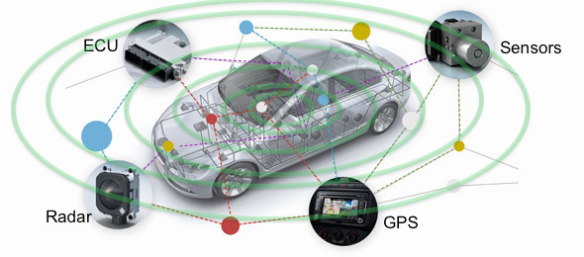
Introduction
The need for
data communication systems in vehicles
is rapidly growing
Data networks are needed to integrate increasingly sophisticated electronic systems that improve:
Security
Efficiency
Reliability
Comfort
Sample Applications:
Advanced Driver Asistance Systems (ADAS)
Infotainment
Powertrain

Slide 3
Introduction
Increasing demands require increasing complexity of data networks in vehicles
Increasing complexity requires:
Higher Speed
Real-Time Data Transmission
Low-Latency
Reliability
Cost Efficiency
Which are limited with current technologies

Slide 4
Introduction
Current Technologies are becoming unsuitable to embrace the challenges in implementing faster and more reliable data networks at a competitive cost
Challenges:
Scalability
Standardization
Flexibility
Cost Predictability
Performance
Reliability
Environmental Challenges:
Vibration
Temperature
Weight
Electromagnetic Compatibility
Length
Maintenance

Slide 5
Introduction
Examples of Today’s Technologies:
Controller Area Network (CAN)
Local Interconnect Networking (LIN)
Low Voltage Differential Signaling (LVDS)
MOST
Are not suitable to face the challenges in:
Scalability
Standardization
Flexibility
Cost Predictability
Performance
Reliability

Slide 6
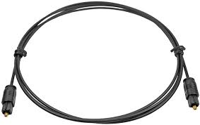
Introduction
The solution is a simplified approach:
Ethernet + Plastic Optical Fiber (POF)

Slide 7
Introduction
Ethernet is:
Scalable
Standard
Flexible
Cost Efficient
POF is best for:
Vibration
Temperature
Weight
Electromagnetic Compatibility (EMC)
Length
Maintenance

Slide 8
Introduction
KDPOF’s Technology:
Ethernet
POF
An ASIC that implements:
Data Transmission over POF
Data Transmission Rate of 1Gbps (Gigabit per second)
Ethernet Compatible
Reliable
Cost Effective

Slide 9
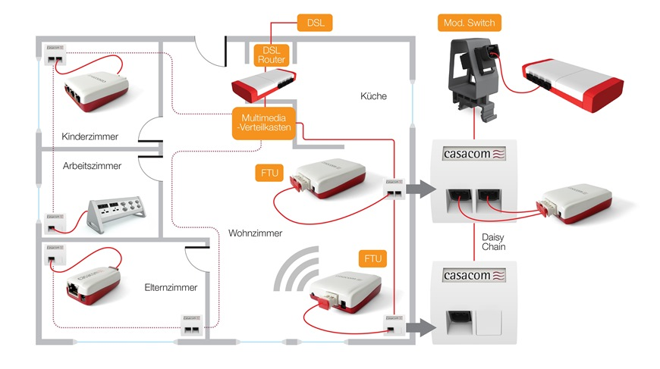
Introduction
KDPOF’s Current Technology:
KD1000 Family
KD1001
KD1002
KD1011
KD1012
Currently for Consumer & Industrial Applications

Slide 10
Introduction
KDPOF’s Steps Towards Next Generation Technology:
Adaptation to Automotive

Slide 11
Introduction
KDPOF is using a Phase 2 SME Instrument from the European Commission’s Horizon 2020 Framework Program for Research & Innovation to take the next vital steps towards developing and standardizing a new technology for data communications in automobiles.
The Project
May 2015 – May 2017
Pre-Qualification of a Gigabit Ethernet POF Transceiver for Automotive Applications

Slide 12
Project Overview
The Project
Objective
To develop an ASIC that can function as a PHY device for Gigabit Ethernet over POF in automotive data networks and to demonstrate that it can comply with the design, robustness and reliability expectations and requirements of the automotive industry.

Slide 13
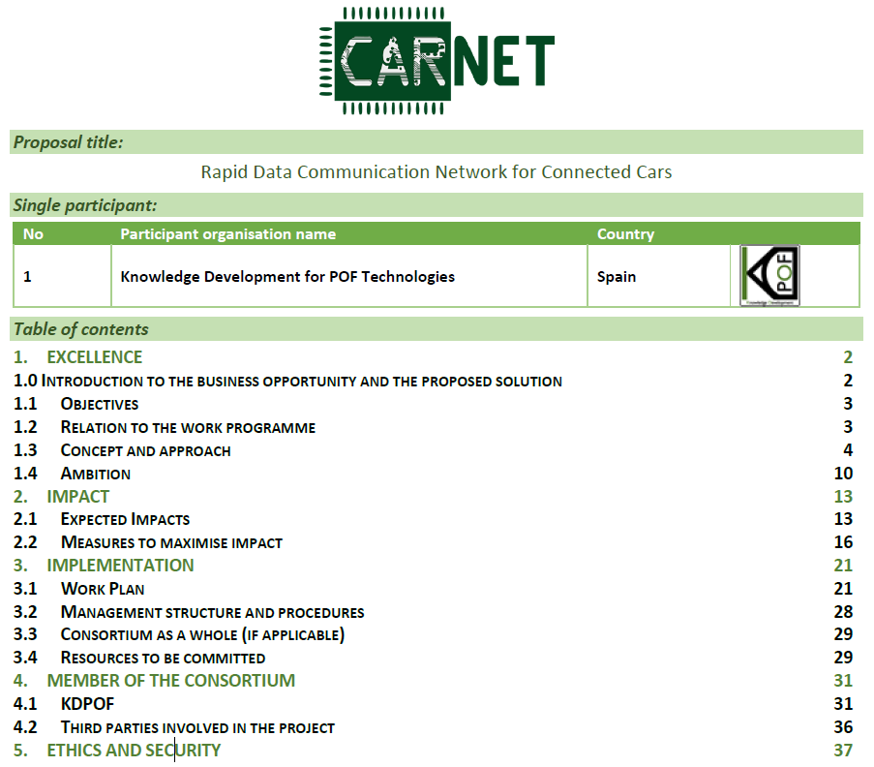
Introduction
Proposal ID: 666449

Slide 14
Project Overview
The Project
Work Packages
Design & Adaptation
Pre-Qualification
Integration & Demonstration
Commercial Engagement
Market Watch & IPR
Market Strategy & Business Plan
Project Management

Slide 15
Project Overview
Work Packages | Tasks | Milestones
DESIGN AND ADAPTATION TO AUTOMOTIVE INDUSTRY | Functional and performance requirements | Comprehensive requirements and specifications
 | Design, emulation and verification | Code freeze
 | BE, TO, FAB, Packaging | Tape Out
 | ASIC Bring up | Test-chip
PRE-QUALIFICATION | Mission profile | Mission profile defined
 | Definition of qualification strategy | Specification for robustness design and manufacturing
 | Definition of robustness design and manufacturing | ASIC characterization
 | Spec, design and manufact of test load-board | Pre-qualification report
 | ASIC Characterization
 | Devel Qualification test
 | Assessment of qualification results
INTEGRATION AND DEMONSTRATION | Spec., design and manufacturing of Evaluation Board | Evaluation Board
 | Assembly
 | Test
COMMERCIAL ENGAGEMENT | Gather inputs on functionality and specs | Customer awareness of mission profile and qualification strategy
 | Customer test of current technology implementation | Customer awareness of robustness specifications
 | Periodical report of qualification plan and results | Customer awareness of ASIC characterization
 | Strategic audit of plan with external partner | Customer awareness of ASIC qualification
 | Development of strategic market alliances
 | Standardization for broad market
 | Show demonstrator to customers
MARKET WATCH & IPR | Market watch | EU patent application
 | IPR
MARKET STRATEGY BUSINESS PLAN | Operational Strategy | Investor-ready Business Plan
 | Marketing Strategy
 | Business Plan
PROJECT MANAGEMENT | Administrative and financial coordination
 | Scientific project coordination and management | Project progress meeting

Slide 16
Project Overview
Start Date: May 1, 2015
Milestones | M1 | M2 | M3 | M4 | M5 | M6 | M7 | M8 | M9 | M10 | M11 | M12 | M13 | M14 | M15 | M16 | M17 | M18 | M19 | M20 | M21 | M22 | M23 | M24
Comprehensive requirements and specifications
Code freeze
Tape Out
Test-chip
Mission profile defined
Specification for robustness design and manufacturing
ASIC characterization
Pre-qualification report
Evaluation Board
Customer awareness of qualification strategy
Customer awareness of robustness specifications
Customer awareness of ASIC characterization
Customer awareness of ASIC qualification
EU patent application
Investor-ready Business Plan
Project progress meeting

Slide 17
Project Overview
End Date: April 30, 2015
Final Outcome Expected:
Test Chip
Qualification Report
Evaluation Board/Kit
Available for Customer (Automotive OEM) Evaluation

Slide 18
Questions
&
Answers

